Slide 1
EMHF Conference 2015
www.destinationeuroperacing.com

Slide 2
ITM - Introduction
Charles O Neill
Chief Executive Officer
Irish Thoroughbred Marketing
ITM Established 24 years - the longest established Thoroughbred Marketing establishments
Our goal is to promote all aspects of the Irish TB industry around the world and encourage inward investment
Highlight the success of Irish bred horses globally
Enhance racehorse ownership within Ireland

Slide 3
Concept
VISION
A strategic alliance between committed parties to maintain and grow the awareness, attraction, and involvement of global participants in European racing, breeding and bloodstock industries. Current partners’ include, EBF, FRBC, GBRI, ITM and GTM.

Slide 4
Concept
MISSION STATEMENT
‘Destination Europe’ will deliver a coordinated and impactful marketing campaign that will utilise media, events, and PR to generate awareness of the quality and success of European bloodstock as well as the values of racing in Europe; in order to raise the profile and educate international horsemen on the desirability of Europe as a premier horseracing destination.

Slide 5
Management
FULL PARTNERS
ITM, GBRI, EBF and FRBC are equal partners in this initiative. Strategic decisions, including the brand identity and use of the shared funds, will sit with these four partners. All decisions are mutually agreed.
JUNIOR PARTNERS
GTM committed a reduced amount and are a junior partner. GTM receive full inclusion of their brand in all advertising and PR, and are invited to join selected events with a small number of their own guests.
COMMITMENT
This management structure and process is outlined clearly in the MOU signed by all parties. Partner meetings are held quarterly.

Slide 6
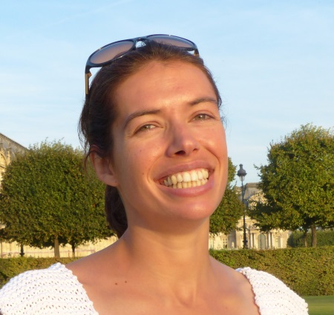
Management
CO-ORDINATOR & MARKETING MANAGER
Late last year, members of Destination Europe agreed on the need to recruit a part-time resource to co-ordinate the work, devise and implement communication & marketing campaigns, etc.
In January 2015, Alix Choppin was appointed as co-ordinator and marketing manager for Destination Europe.
Alix has previously had experience with Weatherbys, the FRBC, Barnes Thompson Ltd, Arqana, and currently works for the TDN in addition to Destination Europe.

Slide 7
Core activates
Advertising campaign
PR strategy
Client development

Slide 8
Key Messaging
Target markets: Primarily the Americas and Australasia.
Showcasing European racing and breeding’s assets, by acting as an access point to all areas of the industry.
Focusing on recent successes to leverage current, high impact winners and statistics.
Maximising the value of European-bred, sourced, and trained stock dominance in elite international racing, to generate increased investment into Europe from our target markets.
Shared ‘call to action’, pushing the target audience equally towards ITM, GBRI, FRBC, EBF & GTM.

Slide 9
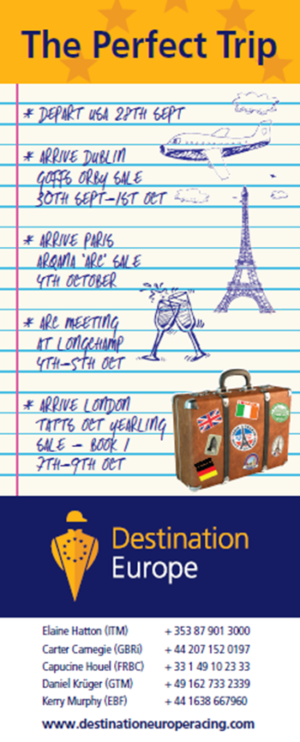
Targeted advertisements to relevant markets
TDN
ANZ
TDN, ANZ, Saratoga Special, Paulick Report

Slide 10
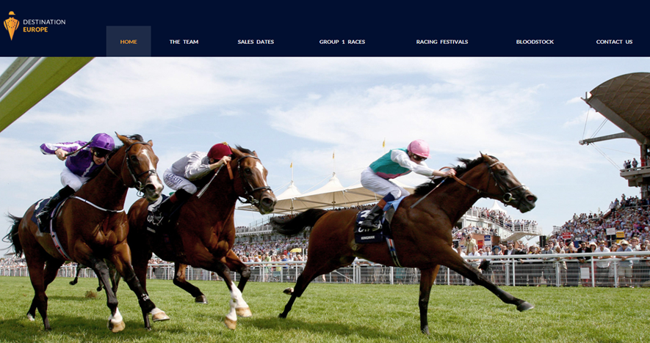
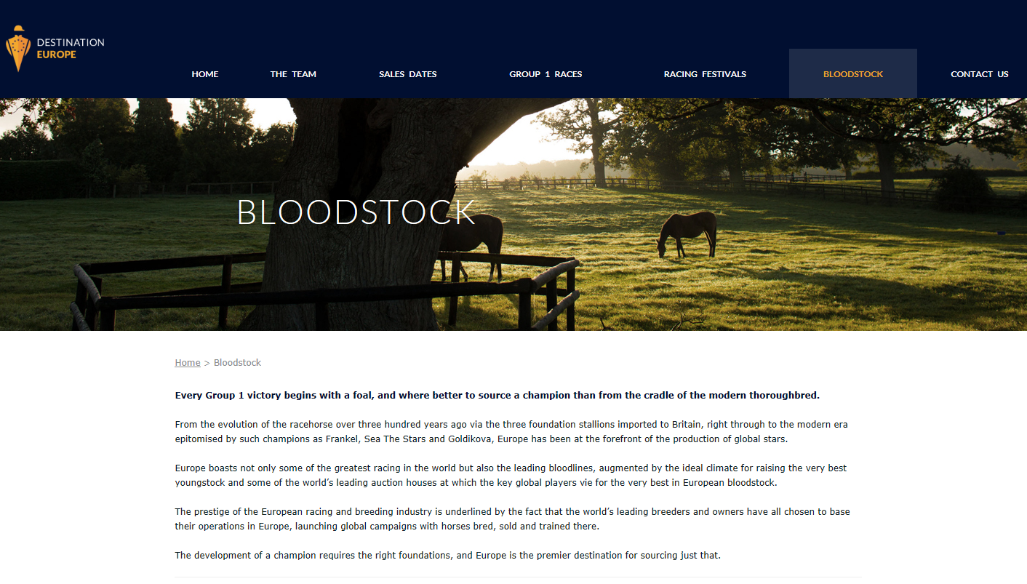
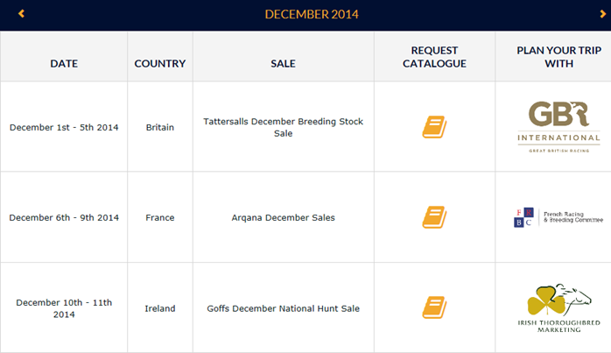
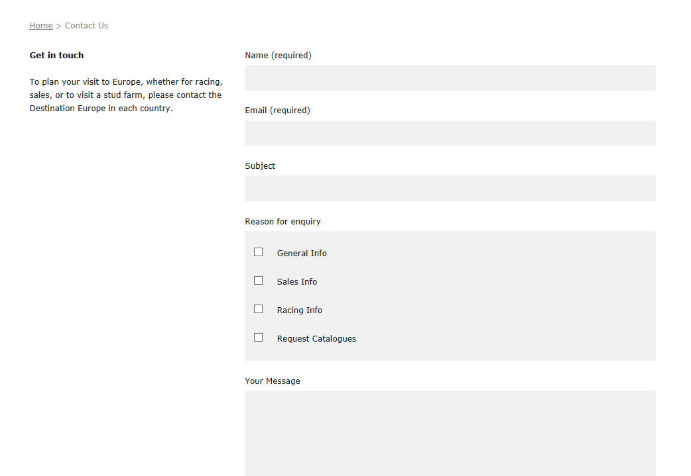
Dedicated Website
www.destinationeuroperacing.com
Home page
Bloodstock page
Sales Dates page
Data capture opportunity
Contact page
Data capture opportunity

Slide 11
Branding
ANZ Branding
TDN Branding
Destination Europe branding agreements
TDN
Sponsorship of the European section of the TDN
30 full pages of advertising
ANZ
Sponsorship of the weekly European Round-UP
A monthly half page advert
ANZ Branding

Slide 12
2014 Events
Royal Ascot Drinks and Canapés party
Over 200 invited guests from Australia, North America, Hong Kong and South Africa
Guests included: international owners, trainers, breeders and bloodstock agents
Keeneland Dinners
4 focused and intimate dinners during the Keeneland Sales
Guests included: American owners, trainers, breeders and bloodstock agents

Slide 13
2014 Achievements & Lessons
“Perfect trip” campaign & dinners at Keeneland proved highly effective
Increased involvement of American buyers at European yearling & bloodstock sales: Alex Solis & Justin Litt, Shawn Dugan, Justin Casse etc.
Assessment of Royal Ascot event
Well-attended party, yet including a high number of Europeans who do not belong to Destination Europe’s target population.
Disappointing return on investment
All future events held in core destinations.

Slide 14
2015 Program of events
Qatar International Equestrian Festival
Hospitality at Doha racecourse on February 25, Qatar International Day
50+ selected guests (owners, trainers, breeders and bloodstock agents from Qatar and neighbouring countries)
Inglis Easter yearling sale
Planning to replicate the organisation of intimate dinners, which proved successful last year at Keeneland
Targets: trainers, owners, breeders & bloodstock agents with the right profile to buy / race in Europe

Slide 15
Membership
Partner- €20,000
Strategic decisions, use of the shared funds, inclusion of brand in all advertising and PR sits with all full partners.
Junior Partner- €10,000
Full inclusion of brand in all advertising and PR, and the opportunity to join selected events with a small number of guests sits with all junior partners.

Slide 16
Contacts
Alix Choppin: +33 624 331 189 / info@destinationeuroperacing.com
Elaine Hatton (ITM): +353 87 901 3000 / ehatton@itm.ie
Capucine Houel (FRBC): +33 1 49 10 23 33 / chouel@frbc.net
Carter Carnegie (GBRI): +44 207 152 0187 / ccarnegie@greatbritishracing.com
Kerry Murphy (EBF): + 44 1638 667960 / Kerry@ebfhorseracing.co.uk
www.destinationeuroperacing.com

Slide 17
Thank you for your time.

